Slide 1
D365 Plugins Customizations

Slide 2
Fundamentals
Custom Business Logic
.NET Assembly with C# programming using oops
Event Pipeline Executions
Message, Stages & Images
Executions method
IServiceProvider Interface & Plugin interface
Plugin Context
Singing Assembly
Plugin Registration Tool

Slide 3
More Information
Sync & Async plugin
Plugin Isolations
Shared variable
2 min Timeout
Exception handling
Registration options(Database, Disk, GAC)
Debug plugin profiler
Context Depth
Debugging attached process

Slide 4
When to use Plugin
In Dynamics 365, plugins are used to extend the platform's functionality by adding custom business logic. Here are some scenarios where you might want to use
Data Validation and Transformation
Plugins allow you to validate data before it's saved to the database. For example, you can enforce specific rules or conditions on field values during record creation or update.
You can also transform data—for instance, automatically formatting phone numbers or calculating derived fields.
Complex Business Logic
When you need more sophisticated logic than what workflows or JavaScript can provide, plugins are a powerful choice.
They execute within the database transaction and can perform complex operations, such as interacting with external services or performing calculations.

Slide 5
3. Integration with External Systems
If you need to call external web services or perform actions based on events (like saving or deleting a record), plugins are suitable.
They allow seamless integration with other systems or services.
Custom Actions and Events
- Plugins can be triggered by specific events (e.g., record creation, update, deletion) or custom actions.
- Use them to respond to specific business scenarios or user interactions

Slide 6
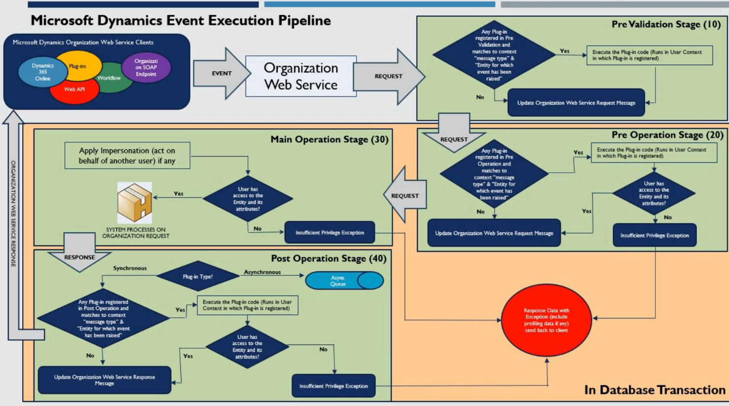

Slide 7
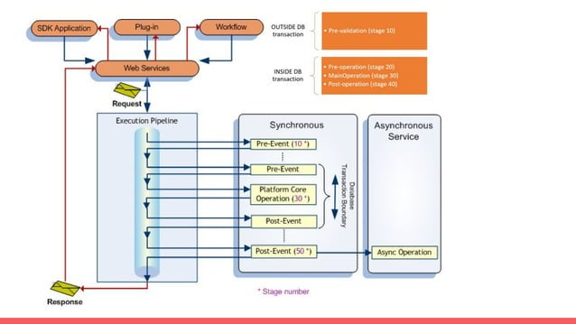

Slide 8
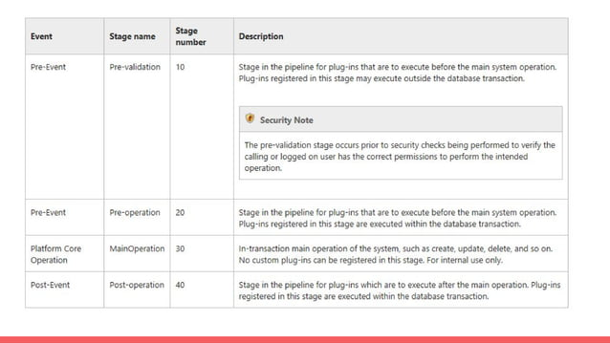

Slide 9
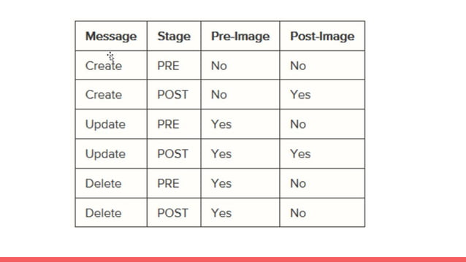

Slide 10


Slide 11
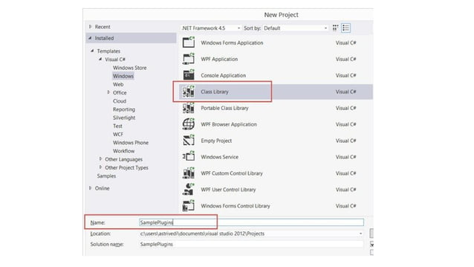

Slide 12
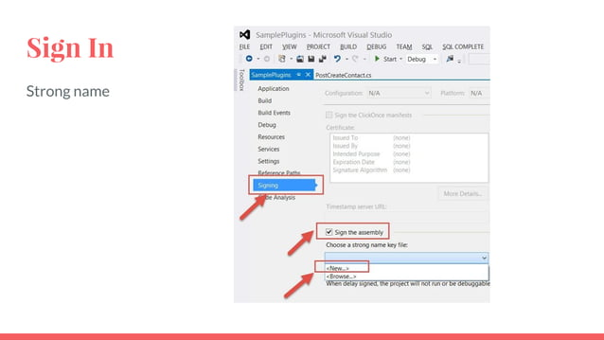

Slide 13
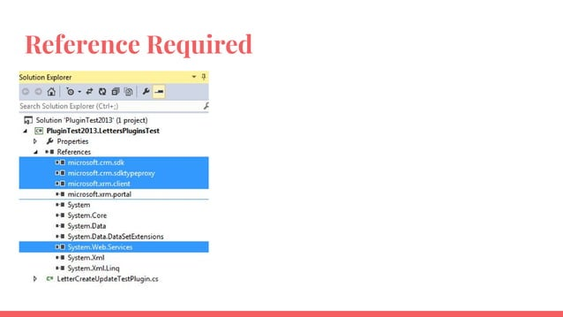

Slide 14
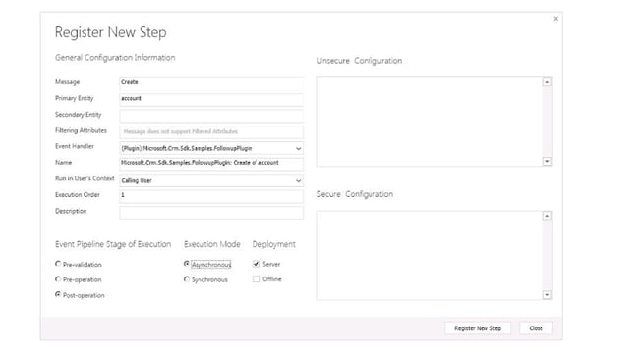

Slide 15


